Slide 1
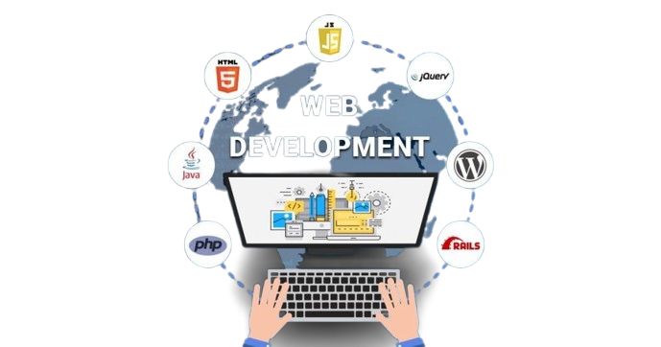
Introduction to Web Development
&
Introduction to HTML and Web Structure

Slide 2

What will you learn?
Internet / Web / Domain / DNS
Browser
Request / Response
Static website / Dynamic website
Front-end / Back-end
Front-end technologies
Back-end technologies
Introduction to HTML

Slide 3


We have an informational connection with the outside world through the Internet and the Web

Slide 4
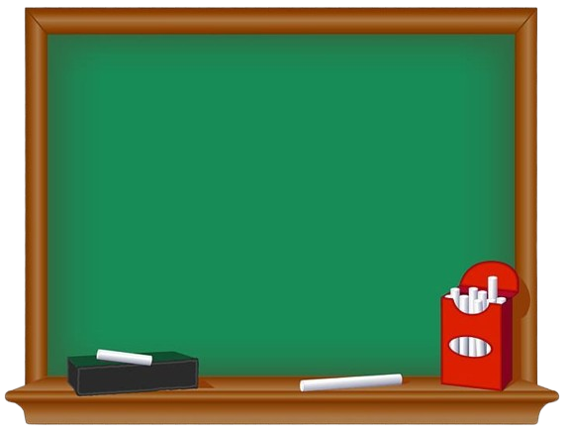

The Internet is a global network through which computers are connected to each other

Slide 5
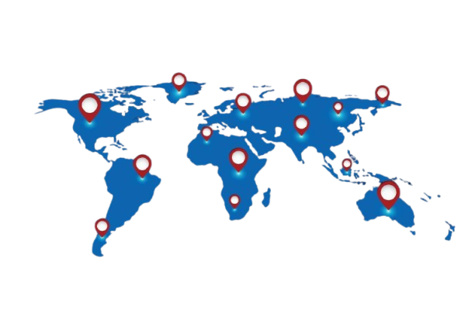
The Internet allows computers to find each other

Slide 6

The Web is a service that allows us to deliver certain information from one computer to another

Slide 7
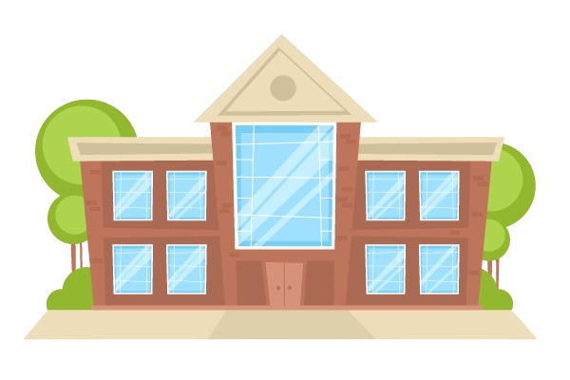

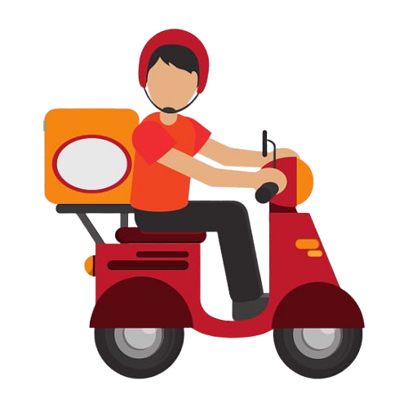


Slide 8
The courier is the Web — the service that ensures the actual transfer of data
The road is the Internet — the physical resource for transferring data

Slide 9
The Web transfers information between computers

Slide 10
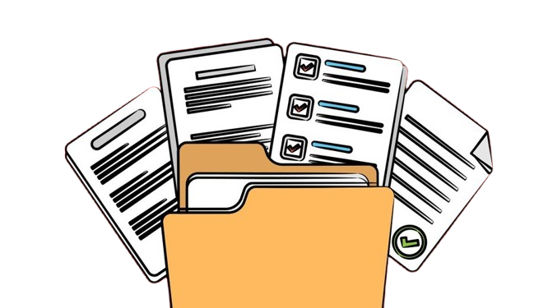
The Web transfers information between computers

Slide 11
The Web transfers information between computers

Slide 12

The Web transfers information between computers

Slide 13
The Web transfers information between computers

Slide 14
The Web transfers information between computers

Slide 15
The Web transfers information between computers

Slide 16
The Web transfers information between computers

Slide 17
THE WEB
🌐
The World Wide Web is an information system where documents are available over the Internet.
These documents are transferred over HTTP

Slide 18
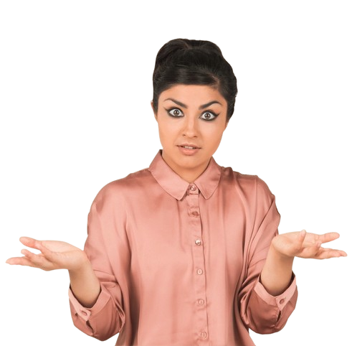
Hyper
Text
Transfer
Protocol

Slide 19

HTTP
HTTP is a formally defined set of rules for communication between a client (requester) and a server (responder)
That’s really all you need to know

Slide 20
In the communication process, there are two parties: the client and the server

Slide 21




I need the necessary files to render the UI
In the communication process, there are two parties: the client and the server
Hey, I have exactly those files
Client
Server

Slide 22
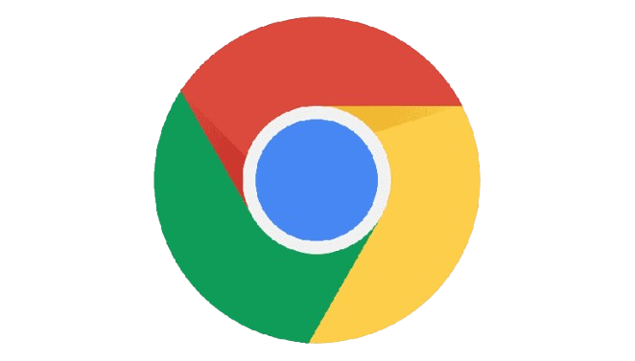


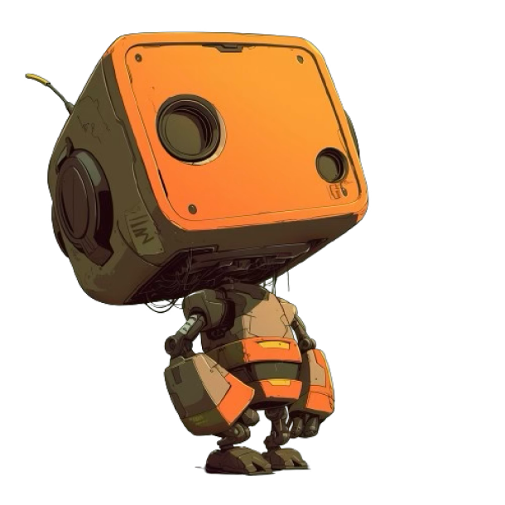
How is this data physically accessible?

Slide 23


The browser is the software that operates based on Web standards and turns Web information into an accessible and interactive experience for the user

Slide 24
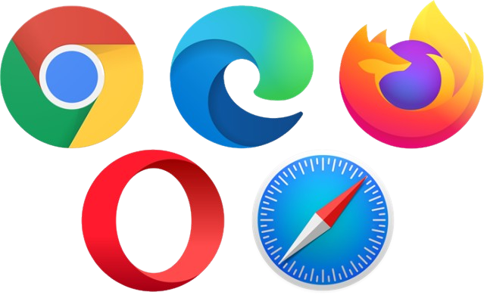
What is Browser?
The browser is software that has the ability to:
1
Request
2
Get Response
3
Process
4
Display (Rendering)

Slide 25
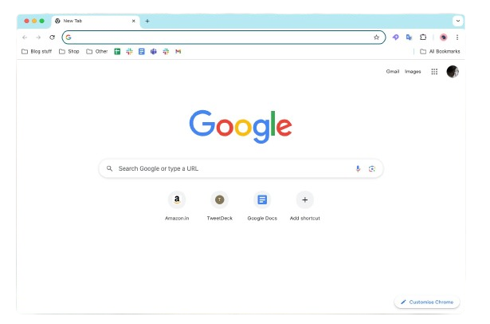

udemy.com
You are writing the website address
The rest of the magic is done by the browser

Slide 26
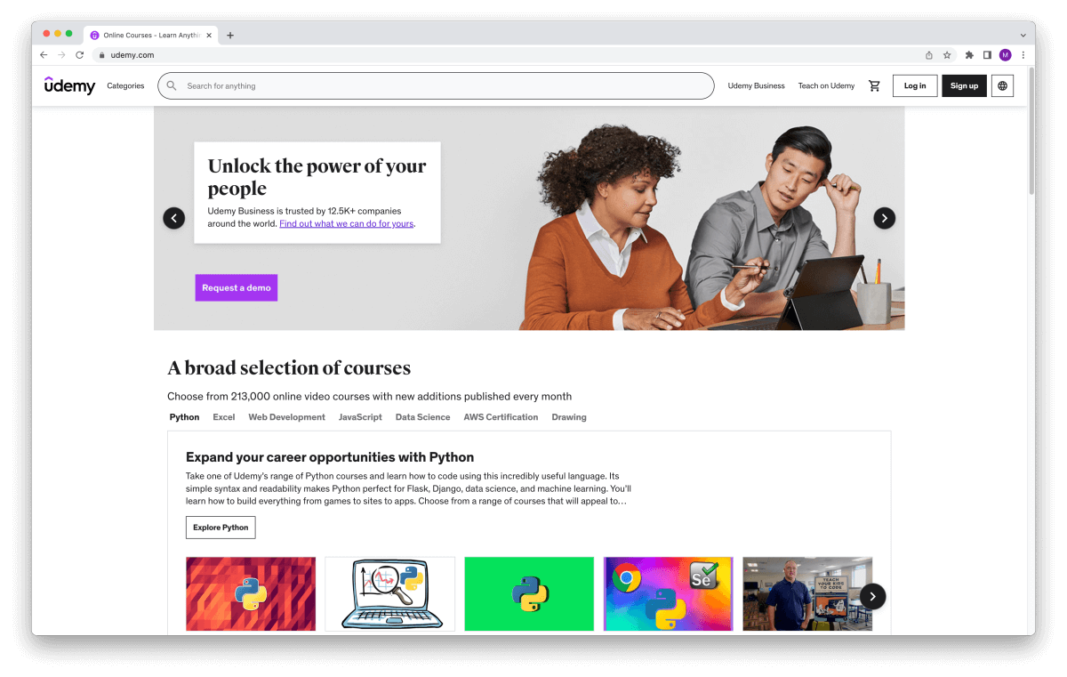
You are writing the website address
The rest of the magic is done by the browser

Slide 27
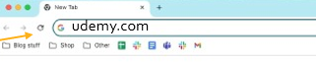
udemy.com
You are writing the website address
The rest of the magic is done by the browser

Slide 28
Every computer has its own unique address, and based on this address, a connection can be established precisely between specific computers
158.63.244.19
189.57.223.14
104.233.71.156
132.50.19.244
23.187.54.102
102.41.66.180
54.201.98.47
176.45.12.88
42.118.90.203
12.74.33.199
73.156.204.11
205.88.17.63
67.92.140.221
91.204.18.77

Slide 29
udemy.com
Domain

Slide 30
The connector between a domain and an address is DNS
A domain is a human-readable and easy-to-remember address that points to a specific computer on the Internet

Slide 31
DNS is a system that works like a phone book. It keeps a record of which address a domain corresponds to

Slide 32

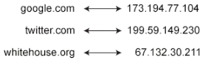
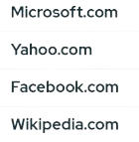
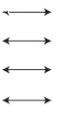
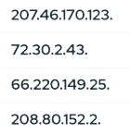
DNS (Domain Name System)
Domain name = IP address
Domain name = IP address

Slide 33

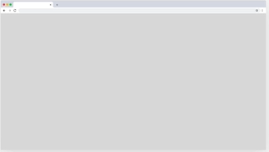
www.omnifood.dev
www.omnifood.dev
23.187.54.102
Browser
👩‍💻

Slide 34

23.187.54.102
www.omnifood.dev
23.187.54.102
Browser
👩‍💻

Slide 35
23.187.54.102
www.omnifood.dev
23.187.54.102
Browser
👩‍💻
Request
Web Server
🌐

Slide 36
www.omnifood.dev
23.187.54.102
Browser
👩‍💻
Request
Web Server
🌐
Response

Slide 37
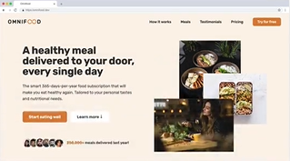



www.omnifood.dev
23.187.54.102
Browser
👩‍💻
Request
Web Server
🌐
Response
The 3 languages that browsers understand
The process of writing
Front-end Development

Slide 38
Static and dynamic
There are two types of websites.

Slide 39
Web site can be static
Websites whose corresponding files are sent directly from the server without transformation are called static websites.

Slide 40
Websites whose content and corresponding files are constantly changing are called dynamic websites
And web site can be dynamic as well

Slide 41
www.udemy.com
www.udemy.dev
192.83.210.15
Browser
👩‍💻

Slide 42
192.83.210.15
www.udemy.dev
192.83.210.15
Browser
👩‍💻

Slide 43
192.83.210.15
www.udemy.dev
192.83.210.15
Browser
👩‍💻
Request
Web Server
🌐

Slide 44

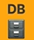



www.udemy.dev
192.83.210.15
Browser
👩‍💻
Request
Web Server
🌐
Response
Back-end languages that run on server

Slide 45
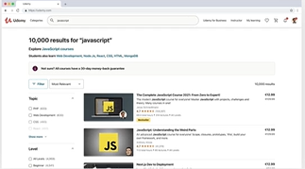
www.udemy.dev
192.83.210.15
Browser
👩‍💻
Request
Web Server
🌐
Response
Back-end languages that run on server

Slide 46
www.udemy.dev
192.83.210.15
Browser
👩‍💻
Request
Web Server
🌐
Response
Front-end
Development
Back-end Development
The process of writing
The process of writing

Slide 47
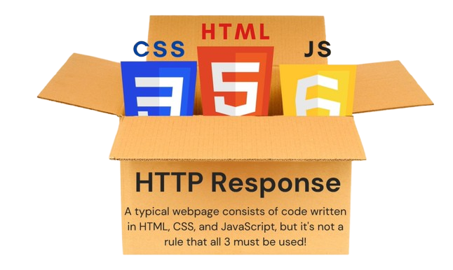

Slide 48
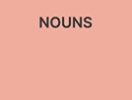
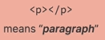
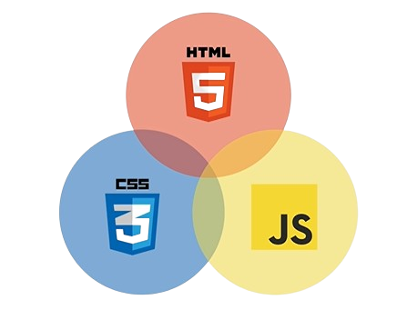
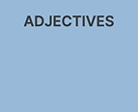
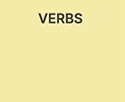
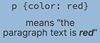
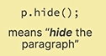
Content
Presentation
Programming Language: Dynamic Effects

Slide 49
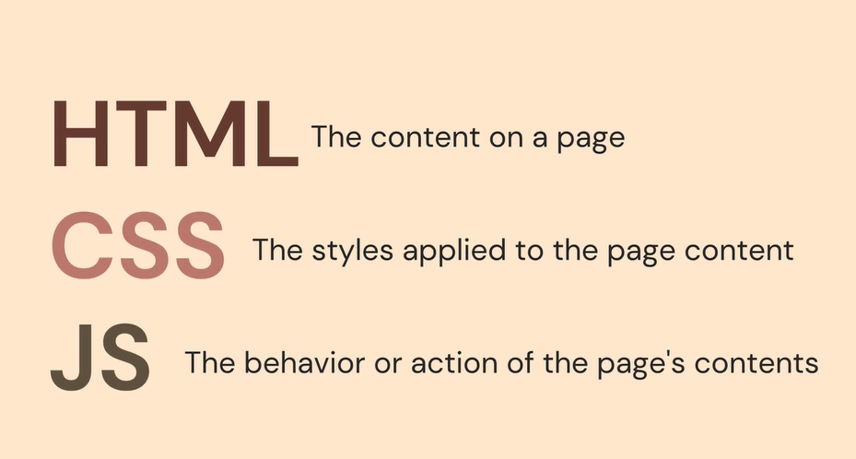

Slide 50

THE
GREEN CSS – The Adjective
ALIEN HTML – The Nouns
DANCES JS – THE Verbs

Slide 51
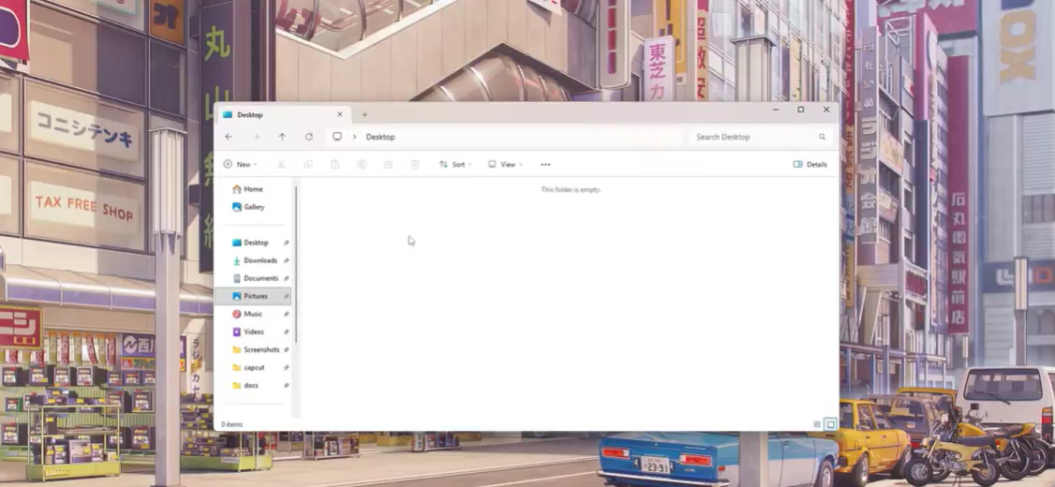

Slide 52
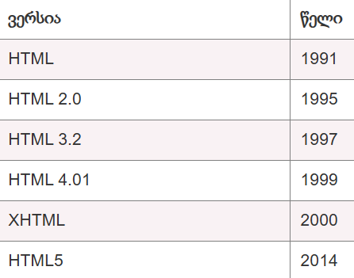
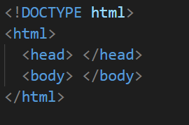
An instruction indicating which version of HTML the page uses

Slide 53
An instruction indicating which version of HTML the page uses
This is the root element of the document. All of our code must be placed inside it

Slide 54
This is the root element of the document. All of our code must be placed inside it
It contains additional information about the document that is not displayed on the screen—for example, the document’s title or any extra resources that the browser needs to use together with the HTML document

Slide 55
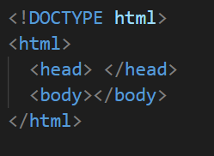
It contains additional information about the document that is not displayed on the screen—for example, the document’s title or any extra resources that the browser needs to use together with the HTML document
This is the visible part of our webpage. In other words, everything the user will see — text, images, tables, etc. — must be placed inside the <body>

Slide 57
This is an HTML tag that serves as an identifier for the browser, indicating which element it should render
Accordingly, every object in HTML must be created using tags
Each object in HTML has its own unique tag

Slide 58
which are represented by opening and closing tags
Each element has a beginning and an end

Slide 59
HTML ELEMENTS
Headings
Paragraph
Links
Div / Span containers
HTML Formatting
HTML Lists
HTML Attributes (style, title, class, id)

Slide 60
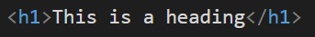
Opening
Tag
Content of the Element
Closing
Tag
HTML elements consist of this structure

Slide 61
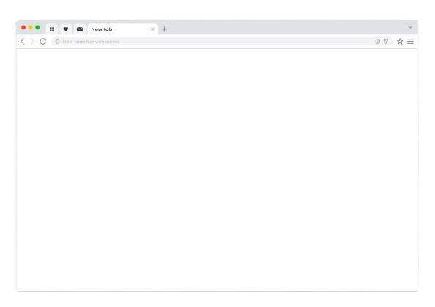
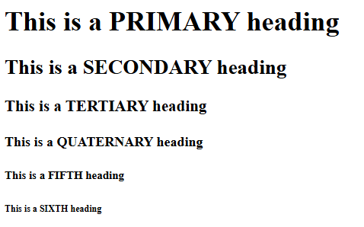
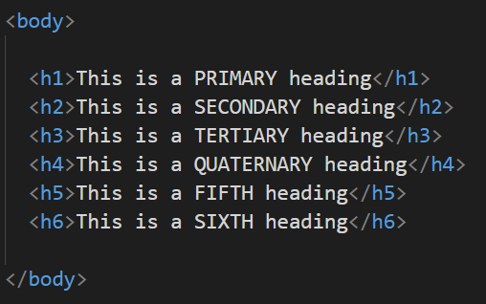
<h1> is the most important heading, and therefore it should be used only once on a page

Slide 62
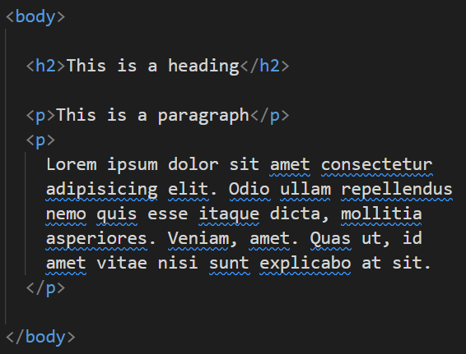
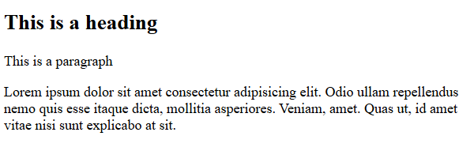
<p> tag is used for a standard text paragraph

Slide 63
We already know two elements
A paragraph is used for standard text, while headings create a hierarchy.

Slide 64
Exactly
In HTML, we also have elements that allow us to format text
Just like in Word?

Slide 65
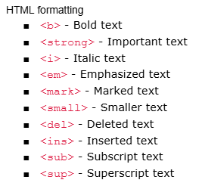

Slide 66
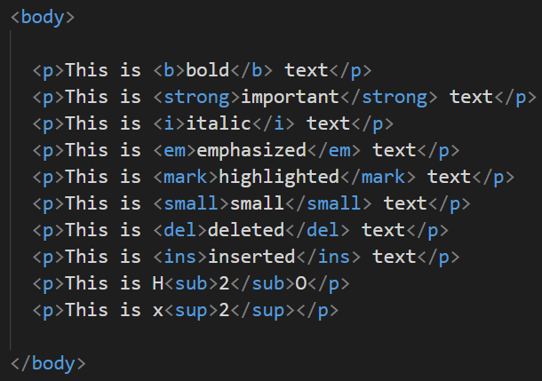
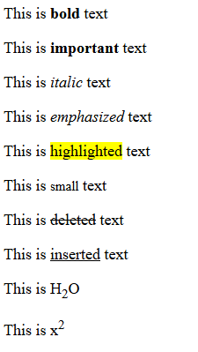

Slide 67
In HTML, we also have elements that allow us to create lists

Slide 68
<ul> (Unordered List): The order of the list items is not important
There are three types of lists
<ol> (Ordered List): The order is important
<dl> (Description List): When we want to create a descriptive structure

Slide 69
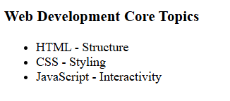
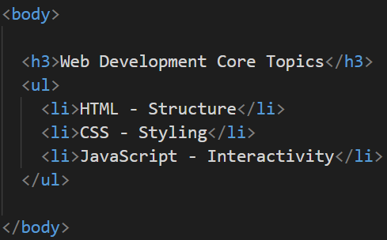

Slide 70
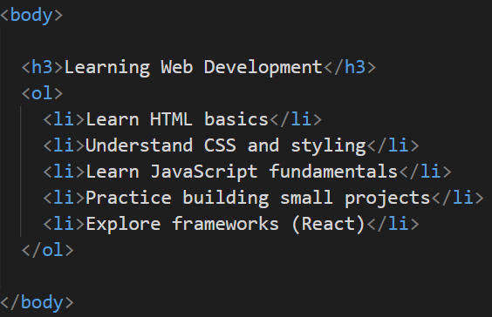
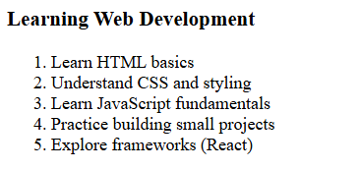

Slide 71
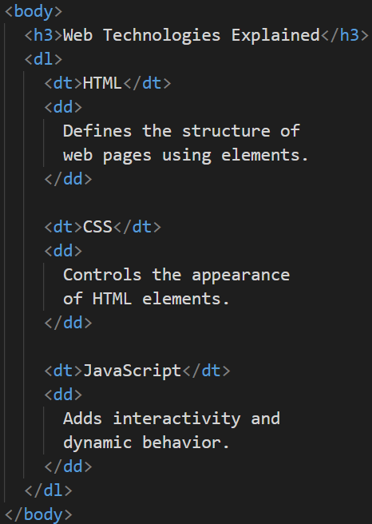
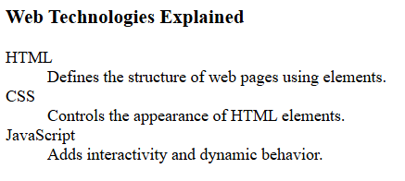

Slide 72
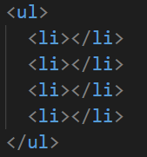
Unordered List
The parent element that tells the browser to create an unordered list
List item

Slide 73

Ordered List
The parent element that tells the browser to create an ordered list
List item

Slide 74

Description List
The parent element that tells the browser to create an descriptive list
Definition Term
Definition Description

Slide 75



Slide 76
In HTML, we have general containers that are used to group elements

Slide 77
<div>: A large box in which we can organize other elements
There are two types of containers
<span>: A small container that is used within text

Slide 78



Slide 79



Slide 80
Block-level Elements: An element occupies the entire line, and the next element always moves to the next line and it can contain other block and inline elements
There are two types of elements
Inline Elements: An element occupies only as much space as it actually needs based on its content, We cannot adjust its width and height and it can contain only other inline elements

Slide 81
BLOCK
BLOCK
BLOCK
INLINE
INLINE
INLINE
INLINE
INLINE

Slide 82
<h1>-<h6>
<p>
<ul> / <ol> / <dl>
<div>
<span>
HTML formatting
Block
Block
Block
Block
Inline
inline

Slide 83

<h1>
<div>
<h2>
<h3>
<div>
<p>
<h3>
<h3>
<div>
<p>
<p>
<p>
<p>
<h4>
<ul>
<div>
<h4>
<ul>
<div>
<ul>
<div>
<div>
<ul>
<b> or <strong>

Slide 85
Attributes are a tool that allows us to assign additional properties to elements
HTML elements have attributes
An attribute is always placed inside the opening tag and has the format name=“value”

Slide 86

The style attribute allows us to apply visual styles to an element
Let's take a look at the style attribute
In the style attribute, we can combine multiple styles

Slide 87



Slide 88



Slide 89

To create a link, we use the <a> tag
With HTML, we can create links

Slide 90
For a link to work, it needs the href attribute, which specifies the address to which the navigation should occur
Just the <a> tag is not enough.

Slide 91



Slide 92


Slide 93


Unicode Transformation Format
Responsive Design
Document title

Slide 94
HTML ELEMENTS
HTML Structure
Headings
Paragraph
Links
Div / Span containers
HTML Formatting
HTML Lists
HTML Attributes (style, href, title)

Slide 95



